Slide 1

6.8 Bases and dimension

Slide 2
Introduction
In this topic, we will
  Define a basis
  Show how to find a basis from a collection of vectors
  See that if the span of two bases are equal,
  both bases must have the same number of vectors
  Define the dimension of a vector space or subspace
  Discuss the benefits of having an orthonormal basis

Slide 3
Definition
To this point, we have simply interpreted a vector as being coefficients of particular values
An alternative interpretation is, however, that these coefficients are coefficients in a linear combination of basis vectors:
  Move u₁ times the length of the first canonical vector in that direction, move u₂ times the length of the second canonical vector in that direction, and so on…

Slide 4
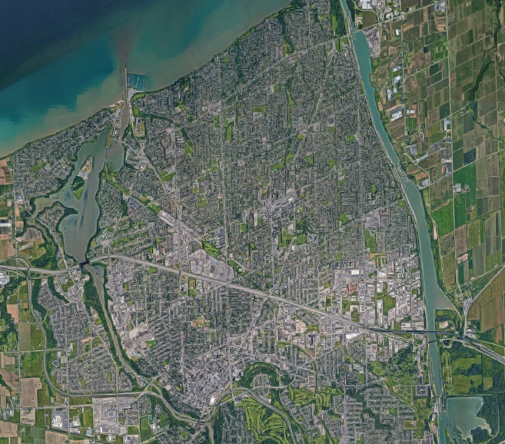
Consider St. Catharines, Ontario

Slide 5
Finding a basis
Also, consider you are dealing with drones and a search-and-rescue
  You know that the objective you are searching for 154 m west of you and 295 m north
  These are coordinates with respect to the canonical basis
  Your vehicle, helicopter, or drone may, however, be facing in a different direction:
    You would like to know where the object is relative to your front and your right

Slide 6
Example
Thus, given a

Slide 7
Example
Do these form a basis, and if not, find a subset that does:
We note that
Thus, a basis for the span is Vectors 1 and 4

Slide 8
Example
Do these form a basis, and if not, find a subset that does:
We note that
Thus, this is a basis for the span

Slide 9
Example
In R^{m}, the m vectors are always a basis
After all, the rank of the corresponding matrix is m

Slide 10
Observations
Theorem
Given two basis of a vector space that is either F^{m} or a subspace thereof,
they must have the same number of vectors.
A sketch of a proof:
Suppose u₁ and u₂ are a basis for a vector space,
and v₁, v₂ and v₃ is a second basis
This must be true, as we must be able to write each of
v₁, v₂ and v₃ as a linear combination of u₁ and u₂

Slide 11
Observations
However, if we performed those exact same row operations
on the matrix
No matter what these values are,
the maximum rank is 2
      Thus, they are not linearly independent
If they are a basis, however, they must be linearly independent
      This leads to a contradiction, and thus both bases
      must have had three vectors ▮

Slide 12
Observations
Also, every different linear combination of basis vectors defines a unique vector in the span
Identically, every vector in the span of a basis must have a unique linear combination of basis vectors that equal it
  If u₁, …, u_{n} is a basis, then given an arbitrary vector v,
  the system of linear equations defined by
  either has no solutions (v is not in the span)
  or it has one unique solution

Slide 13
Definition
Definition
The dimension of the vector space that is the span of n vectors is said to have a dimension of n
  We will describe such a vector space to be an n-dimensional vector space
  If the span of these vectors is a subspace,
  we will describe the subspace as being n-dimensional

Slide 14
Example
For example, every vector in R³ can be written as a linear combination of the three linearly independent vectors
Thus, the span of these vectors is R³ and thus these form a basis for R³, and the dimension of R³ is three
  Thus, every basis for R³ must have three vectors
  Thus, every collection of three linearly independent vectors in R³ is a basis for R³
  This particular basis is called the canonical basis for R³

Slide 15
Example
For example, the following two vectors in R³ are linearly independent:
Because they are independent, they form a basis for their span
Because there are two vectors,
dimension of the span of these two vectors is two
  The span is a plane in R³ that passes through the origin
Because there are only two vectors in this basis,
the span cannot be all of R³
  It is a subspace of R³

Slide 16
Example
For example, the a single non-zero R³ is linearly independent:
Because it is independent, it forms a basis for its span
  That is, it is a basis for all scalar multiples of it
Because there is one vector,
the dimension of the span of this vectors is one
  The span is a line in R³ that passes through the origin
Because there is only one vector in this basis,
the span cannot be all of R³

Slide 17
Bases for R^{m} and C^{m}
We have already seen that these m vectors in F^{m} are linearly independent and therefore form a basis of an m-dimensional vector space
  However, every vector in F^{m} can be written as a linear combination
  of these vectors; thus, the span is all of F^{m}
Thus, all bases of F^{m} must have m vectors,
and any collection of m linearly independent vectors forms a basis
This basis is, however, called the canonical basis for F^{m}
The span of any collection of n linearly independent vectors
where n < m is a basis for an n-dimensional subspace of F^{m}

Slide 18
Orthogonal and orthonormal bases
Definition
If the vectors in a basis are all mutually orthogonal,
that basis is described as being an orthogonal basis
Definition
If the vectors in an orthogonal basis are also normalized,
that basis is described as being an orthonormal basis

Slide 19
Orthogonal and orthonormal bases
Claim
  Given a basis of n vectors u₁, …., u_{n}, if we perform the Gram Schmidt algorithm on these n vectors to get n orthonormal
  vectors , then
  Because each original vector can be written as a linear combination of the orthonormal vectors,
  and because each of the orthonormal vectors is a linear combination of the original vectors,
  their spans must overlap
  But because they are both bases with the same number of vectors,
  these spans must be identical

Slide 20
Orthogonal and orthonormal bases
The clearest benefit of an orthonormal basis is as follows:
  If ,
  we must solve a system of linear equations in order
  to find the coefficients:
  If no solution exists to this system,
  then
Now, given an orthonormal basis,
  Given any v, is the best
  approximation of v in the span of the orthonormal basis
  Also, if and only if

Slide 21
Summary
Following this topic, you now
  Understand the idea of a basis for a vector space or subspace
  Can take a collection of vectors and find a subset that forms a basis for the span of the original collection of vectors
  Know that all bases for a vector space or subspace must have the same number of vectors, at least for finite dimensions
  Are aware that orthonormal bases are better than arbitrary bases, and that it is much easier to work with orthonormal bases
  Understand that the span of a bases equals the span of the orthonormal vectors that result from the Gram-Schmidt algorithm

Slide 22
References
[1] https://en.wikipedia.org/wiki/Linear_independence
[2] https://en.wikipedia.org/wiki/Linear_span
[3] https://en.wikipedia.org/wiki/Basis_(linear_algebra)
[4] https://en.wikipedia.org/wiki/Gram–Schmidt_process

Slide 23
Acknowledgments
None so far.

Slide 24



Colophon
These slides were prepared using the Cambria typeface. Mathematical equations use Times New Roman, and source code is presented using Consolas. Mathematical equations are prepared in MathType by Design Science, Inc.
Examples may be formulated and checked using Maple by Maplesoft, Inc.
The photographs of flowers and a monarch butter appearing on the title slide and accenting the top of each other slide were taken at the Royal Botanical Gardens in October of 2017 by Douglas Wilhelm Harder. Please see
https://www.rbg.ca/
for more information.

Slide 25
Disclaimer
These slides are provided for the ne 112 Linear algebra for nanotechnology engineering course taught at the University of Waterloo. The material in it reflects the authors’ best judgment in light of the information available to them at the time of preparation. Any reliance on these course slides by any party for any other purpose are the responsibility of such parties. The authors accept no responsibility for damages, if any, suffered by any party as a result of decisions made or actions based on these course slides for any other purpose than that for which it was intended.

